Slide 1
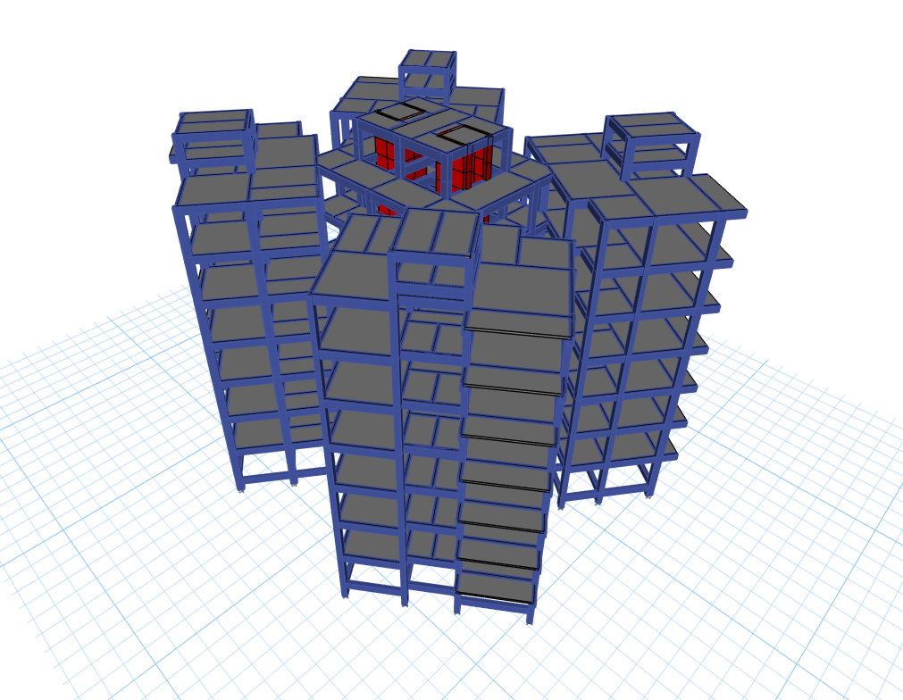
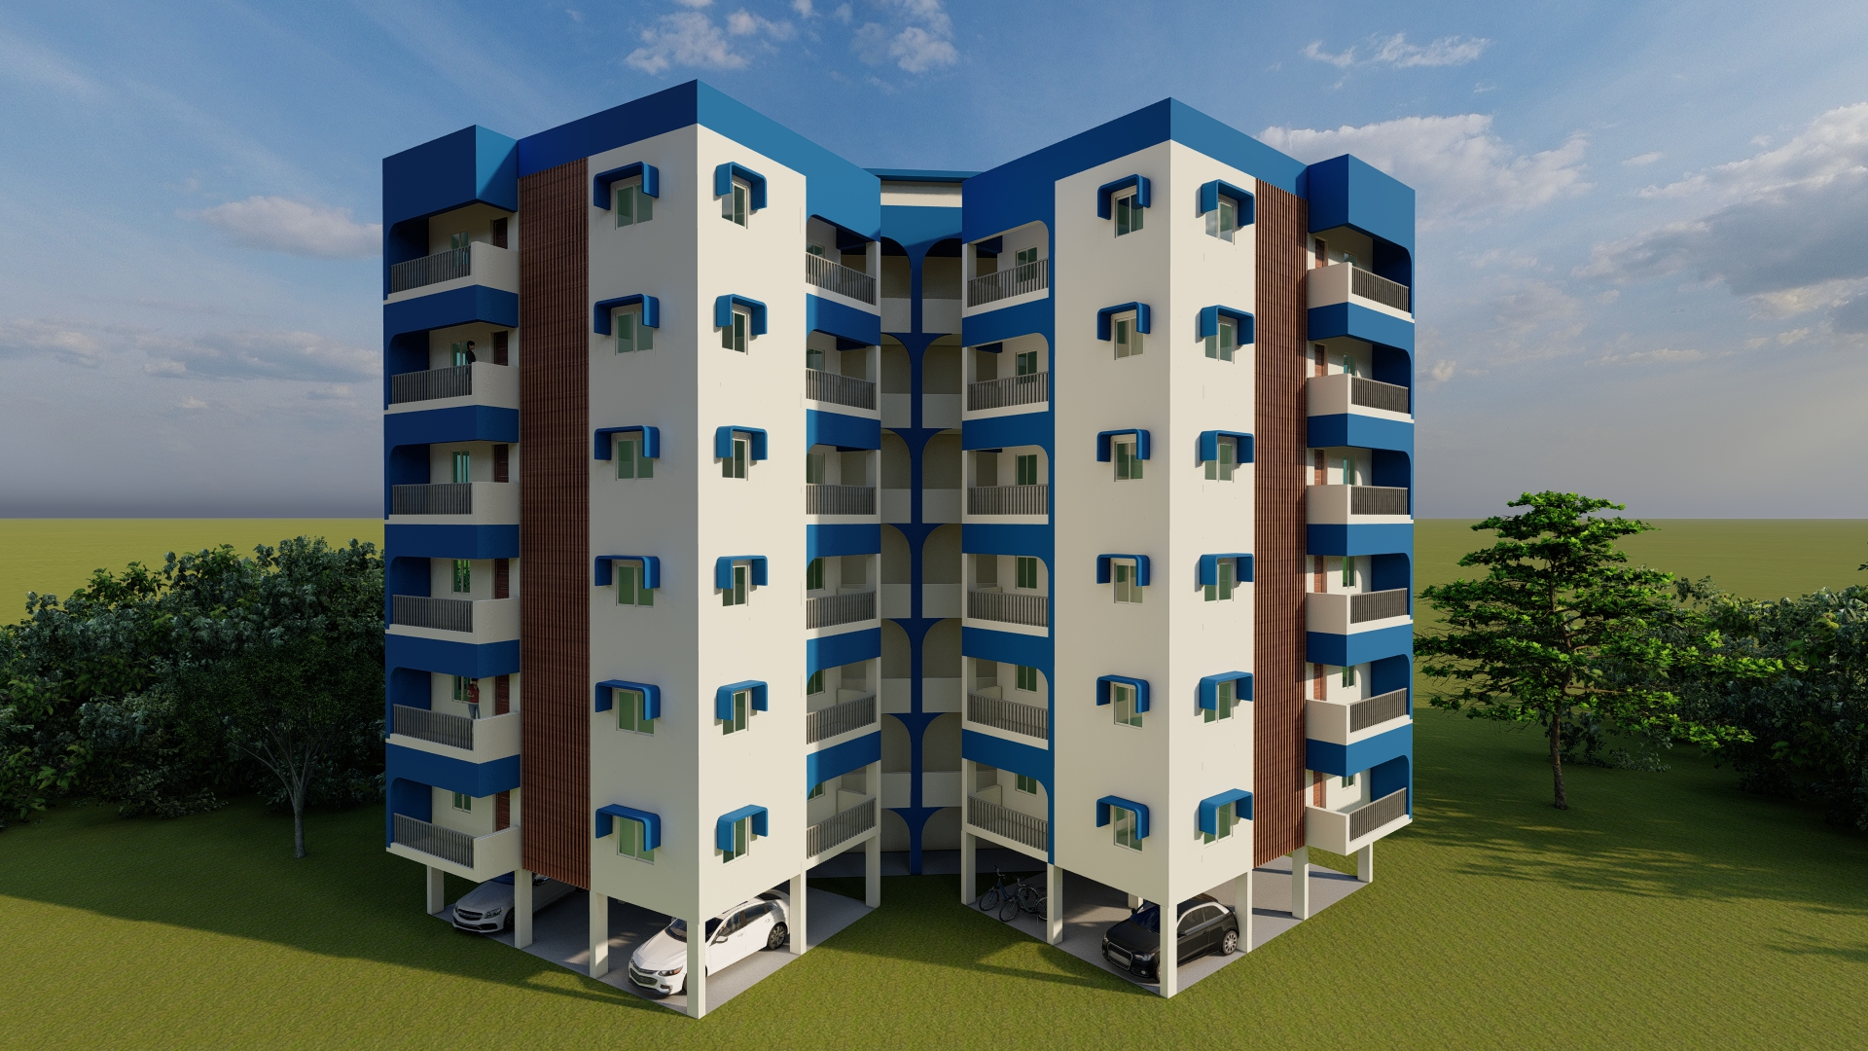

SCC
Our Projects-RCC
PROJECT NAME: STILT+6 RESIDENTIAL BUILDING
CLIENT: SOUTHERN RAILWAYS
LOCATION: ICF, CHENNAI
PROJECT DETAILS: The building extends to a floor area of 4200 Sqft with 4 dwelling units at each storeys. The shear wall is provided in the central core area so as to reduce the seismic load distribution to the RC columns. The foundation is of pile as per the soil report.
STATUS: On going.
08

Slide 2
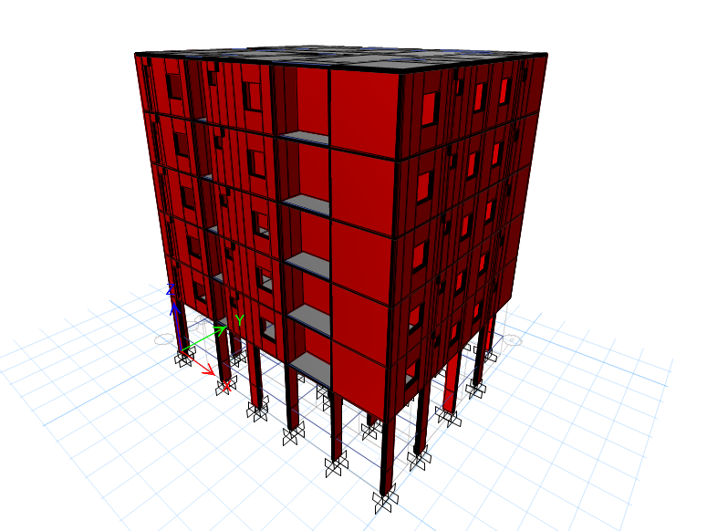
SCC
Our Projects-RCC
PROJECT NAME: STILT PLUS 5 COMMERCIAL BUILDING
CLIENT: MARUTHI DEVELOPERS
LOCATION: COIMBATORE
PROJECT DETAILS: The building extends to a floor area of 3000 Sqft with 2 dwelling units on each storey. The building is made up of mivan structural systems where each wall is of RC wall of 150 thick. Spandrel beams are provided at the place of windows and doors. Drawings has been provided for each and every grid of the structure for better understanding.
STATUS: Completed.
09

